Slide 1
21AIE112 EOC-2 PROJECT
BY BATCH-A GROUP-11
Jammula Veera Venkata Aakash [CB.EN.U4AIE21019] RAKHIL M.L [CB.EN.U4AIE21048]
Reddy Hema Radhika [CB.EN.U4AIE21050] Thanga Rohan [CB.EN.U4AIE21069]

Slide 2
Table of contents
01
02
03
04
STRING LIBRARY
MORSE CODE
BY HEMA RADHIKA
BY THANGA ROHAN
QUEUE
TIC-TAC-TOE
BY RAKHIL.M.L
BY AAKASH JAMMULA

Slide 3
Write the Jack program of the given task and Compile and successfully simulate it on VM Emulator.
PART-1

Slide 4
STRING LIBRARY
01
Functions in String library are few of inbuilt function which we have implemented in a fashionable way.
These function include Strlen, Strcmp, Strappend.
Returns the length of the String, Appends two Strings and returns the merged String, Checks if strings are equal or not respectively.

Slide 5
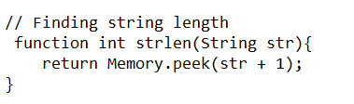
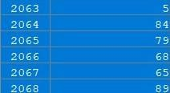
string LENGTH
JACK CODE :
PSEUDO CODE :
Function int strlen(Argument1) {
//returns the value of the memory where String class stores the iteration of each character append which is used to form the string
}
Stores the iterations
5 iterations
ASCII value of T in TODAY
ASCII value of O in TODAY
ASCII value of D in TODAY
ASCII value of A in TODAY
ASCII value of Y in TODAY

Slide 6
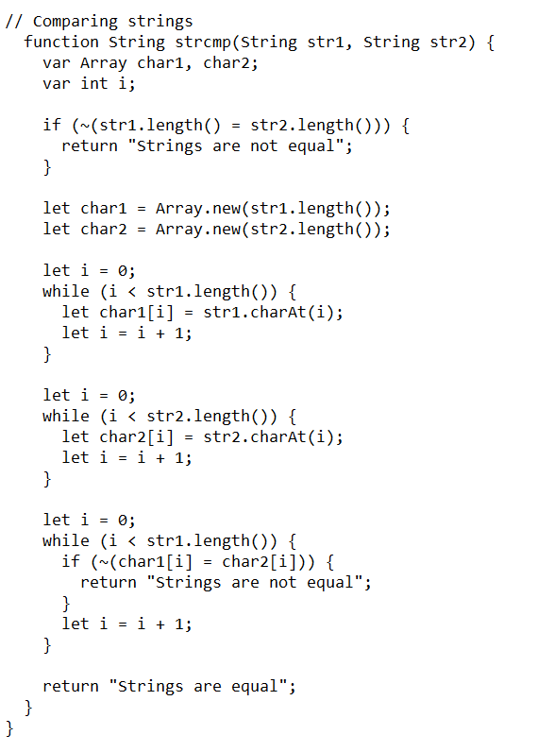
string COMPARE
JACK CODE :
PSEUDO CODE :
function String strcmp(Argument one, Argument two) {
//stores each character of given string in character Arrays and checks each character at each index
}
Let i = 0
while (i < Argument one.length()) {
if (~(char1[i] = char2[i])) {
//returns if strings are not equal
}
Let i = i+1 //iterates
}
//returns if strings are equal
}

Slide 7
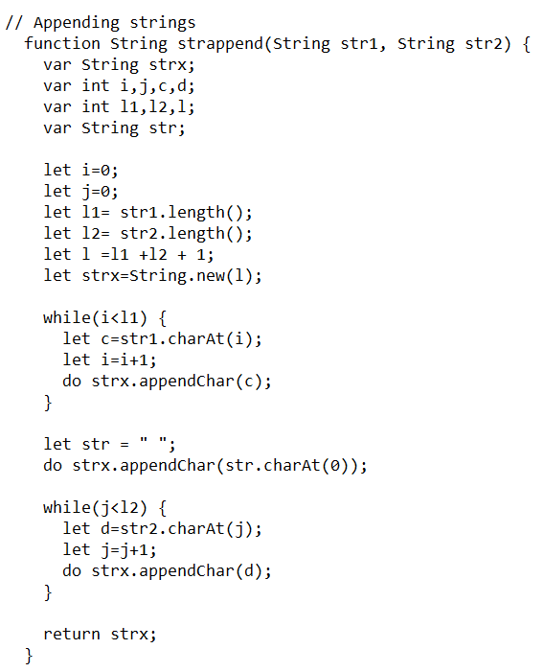
string APPEND
JACK CODE :
PSEUDO CODE :
function String strappend(Argument one, Argument two)
{
//appends the char argument one into a String strx
//then appends the char str(“space”) into strx
//appending argument two into strx
}
//Returns the merged string (string strx)
}

Slide 8
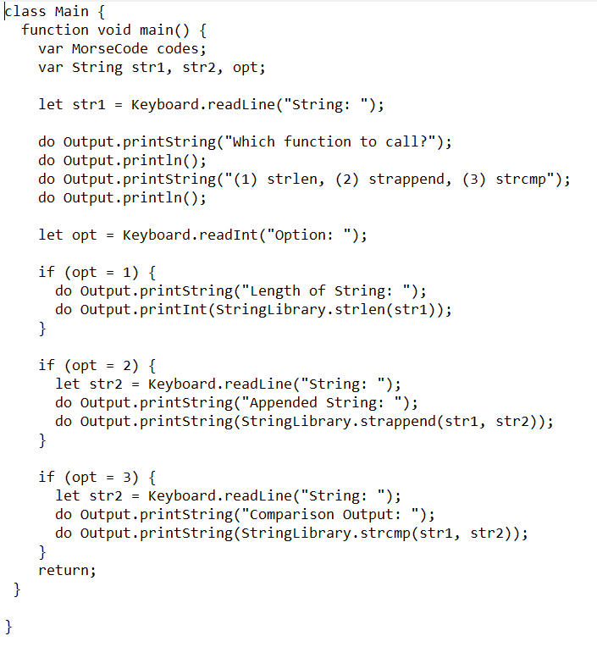
Main.JACK
//Takes input from the user (string)
//Then asks which function to call
//Strlen gives the length of the string
//Strappend gives the appended string
//strcmp gives the comparison output

Slide 9
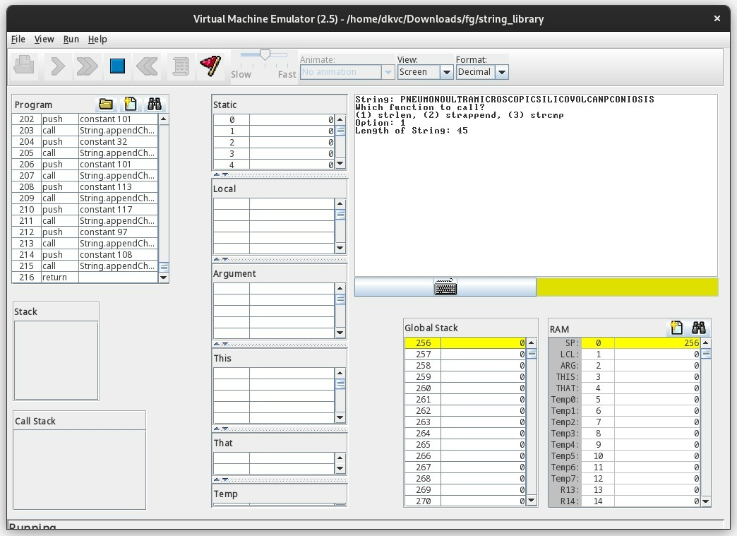
String LENGTH
OUTPUT

Slide 10
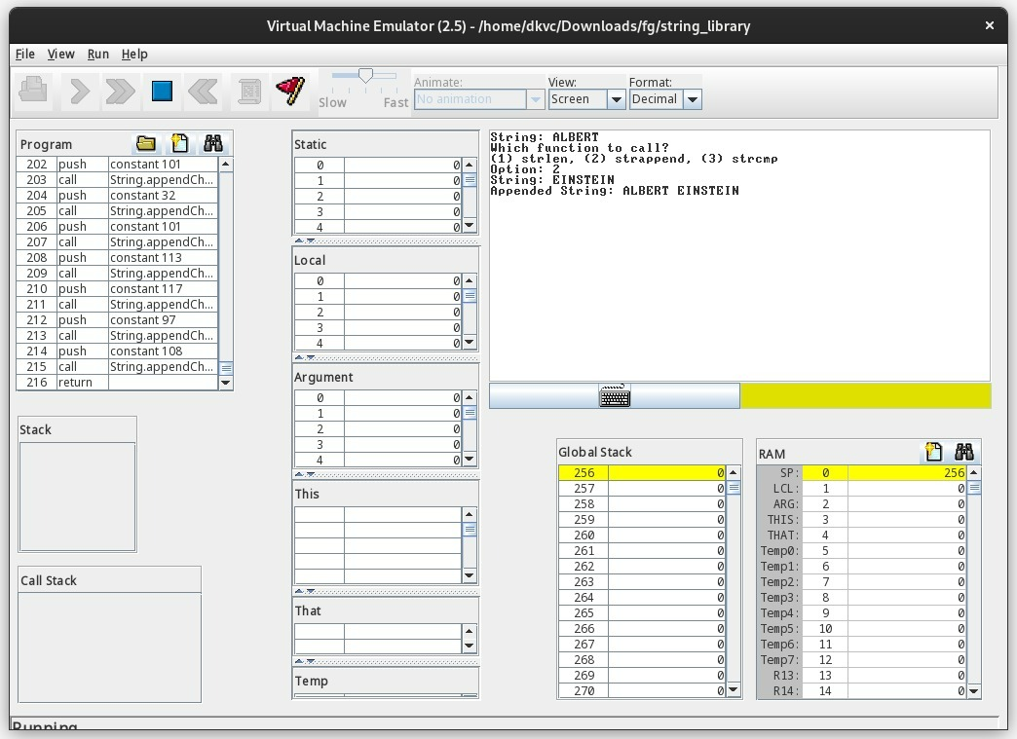
String APPEND
OUTPUT

Slide 11
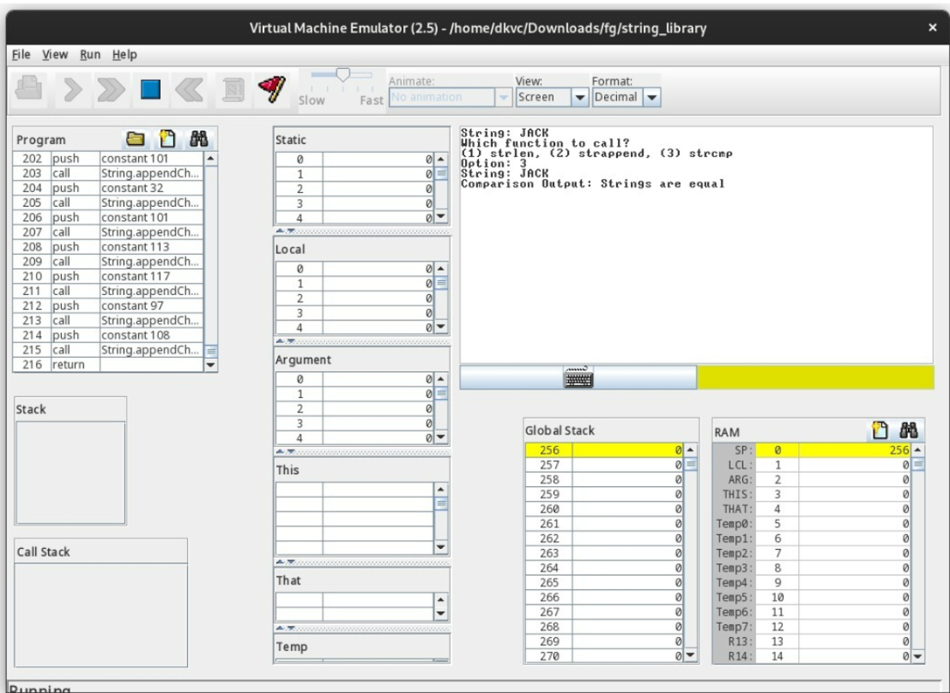
String COMPARE (STRINGS ARE EQUAL)
OUTPUT

Slide 12

String COMPARE (STRINGS ARE NOT EQUAL)
OUTPUT

Slide 13
string SPLIT (EXTENDED LIBRARY)
PSEUDO CODE :
function Array split(Argument one, Argument two){
//array length(let length = stringsplit.countWords(str, delim))
//Splits the String before de-lim
//stores it in an array using temp and returns the array
}
function int countWords(Argument one, Argument two){
//If length is zero, it returns zero //counts the number of words in the given string at the delim
}

Slide 14
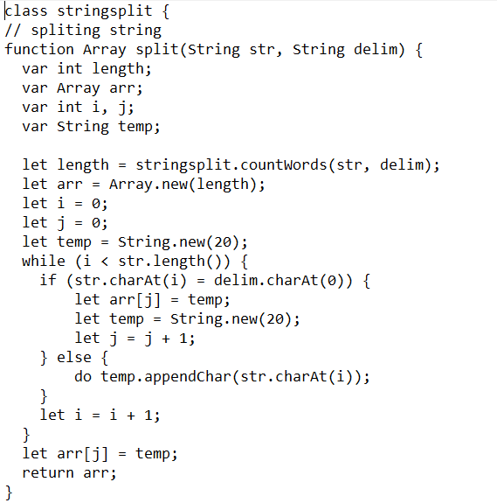
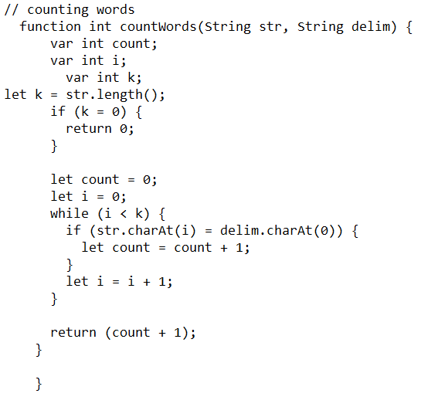
string SPLIT (EXTENDED LIBRARY)
JACK CODE :

Slide 15
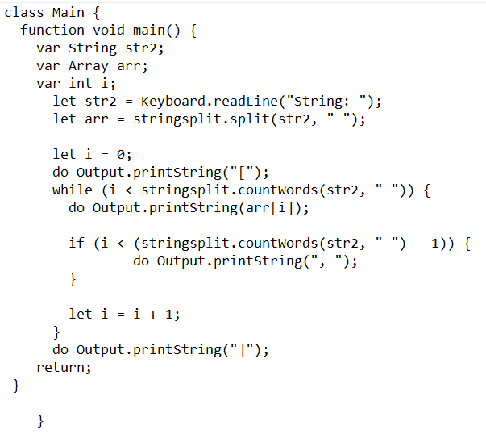
Main.JACK
//Takes input from the user (strings)
//stringsplit splits the given string into the array
// Printing the elements in Array

Slide 16
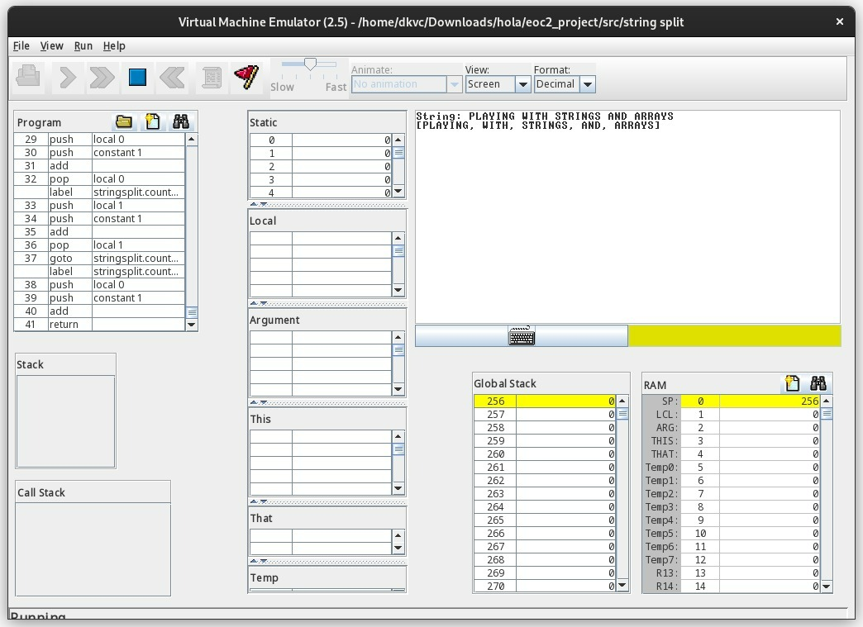
String SPLIT
OUTPUT

Slide 17
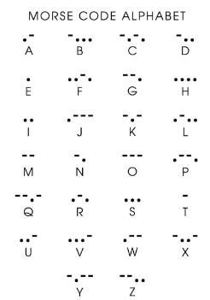
MORSE CODE
02
Morse Code is most prevalent in Aviation and Aeronautical fields since radio navigational aids such as VOR’s and NDB’s still identify in Morse Code. US Navy and Coast Guard still use signal lamps to communicate via Morse Code. Morse Code has also been used as an alternative form of communication for people with disabilities.

Slide 18
MORSE CODE
PSEUDO CODE :
class MorseCode {
constructor MorseCode new() {
//creating a constructor
let eng = "ABCDEFGHIJKLMNOPQRSTUVWXYZ1234567890";
// eng to store alphabets //Morse to store Morse code of the respective alphabet or letter
}
method void toMorse(Argument one) {
//Then method toMorse is used to take Argument one and then comparing each of character to the array and print its morse code.
}
}

Slide 19
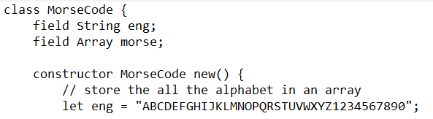
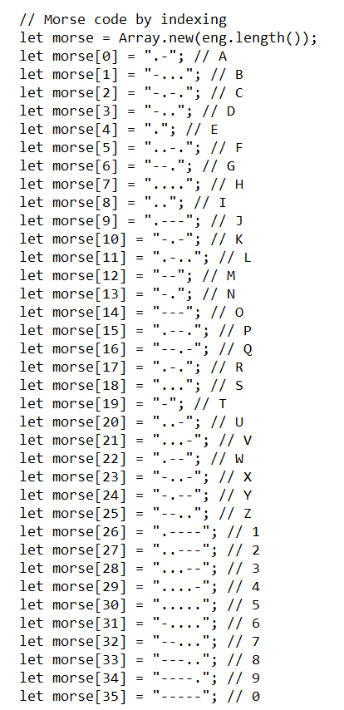
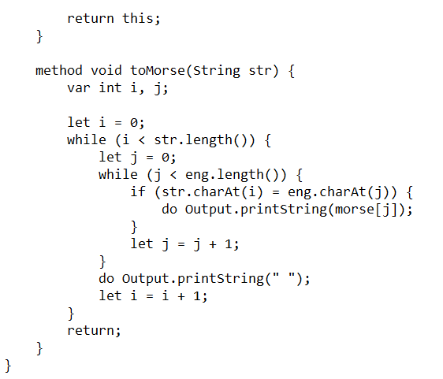
MORSE CODE
JACK CODE :

Slide 20
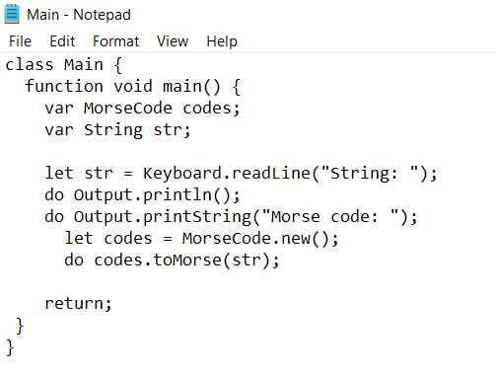
Main.JACK
//constructor used to create a new object(code) of morsecode
//we are using tomorse() to translate english to morsecode

Slide 21
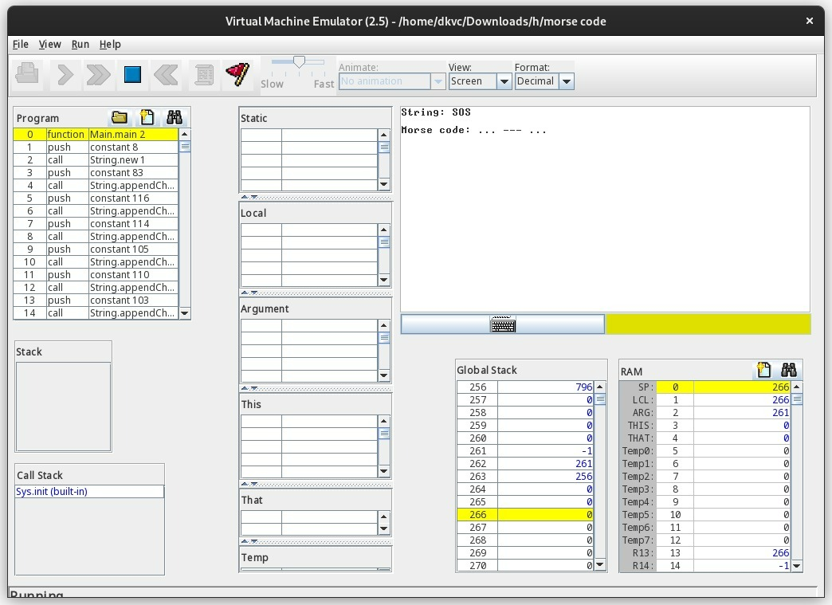
MORSE CODE
OUTPUT

Slide 22
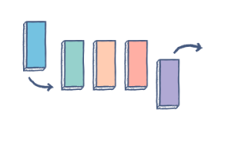
QUEUE
03
Queue is a common data structure that places elements in a sequence, similar to a stack.
A queue uses the FIFO method (First In First Out), by which the first element that is enqueued will be the first one to be dequeued.

Slide 23
QUEUE
API :
Fields for storing values in queue
variables | Description
arr | Stores corresponding values of Queue
front | Returns the position of value First to Queue
rear | Returns the position of value last to Queue
capacity | store the length of arr

Slide 24
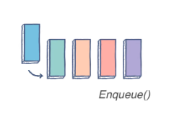
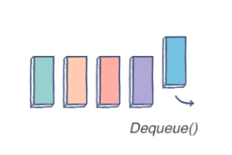
QUEUE
Methods for Queue class
Variables | Parameters | Return type | Description
Constructor | Size (integer) | Object (queue) | Creates an instance of class queue
Enqueue | Value (integer) | Void | Adds a value to corresponding queue
Dequeue | - | Integer | Removes a value from the corresponding queue
Capacity | - | Integer | Returns size of corresponding queue
Front | - | Integer | Returns value at top of the queue
Rear | - | integer | Returns value at bottom of the queue

Slide 25
QUEUE
Checks Methods for Queue class
Variables | Parameters | Return type | description
isEmpty | - | Boolean | Checks whether the queue is empty or not
isFull | - | Boolean | Checks whether the queue is full or not

Slide 26
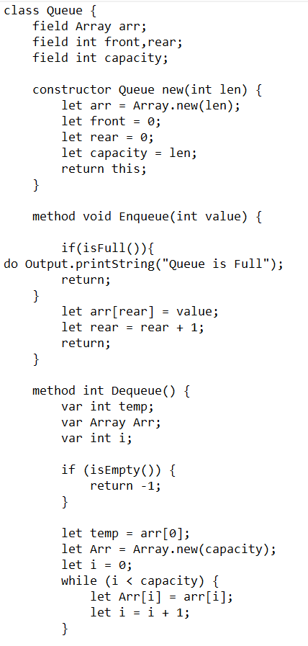
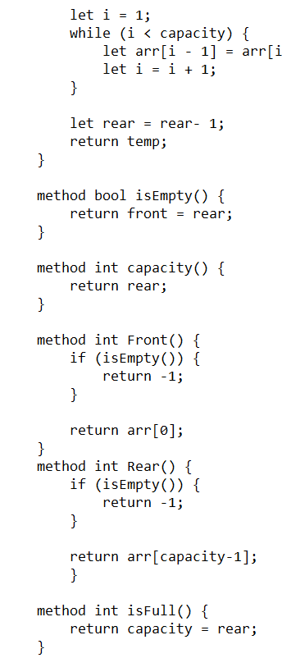
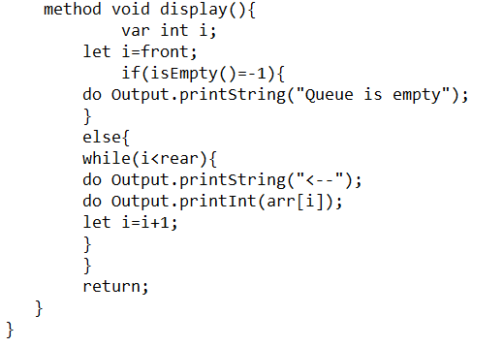
QUEUE
JACK CODE :

Slide 27
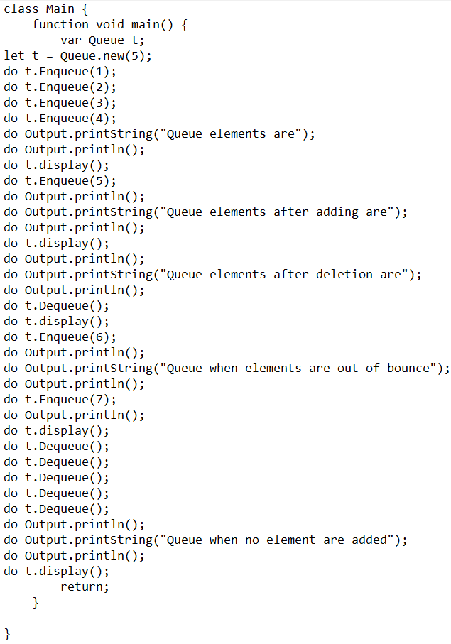
Main.JACK
//First creating a new Queue of Capacity 5.
//Here we are checking if the Queue work by testing the four criteria.
//First adding - We are adding four elements (1,2,3,4) respectfully and checking if they are added by printing the elements of Queue using Display().
//Second removing - We are removing an element and checking if the first element is removed by printing the elements of Queue using Display().
//Third if more elements are add to a queue - Adding 5 elements (2,3,4,5,6) respectfully to a queue of capacity 5 and adding an 7th element to check if the queue is going out of bounce.
//Fourth isEmpty - Removing all the elements and checking if the string is empty.

Slide 28
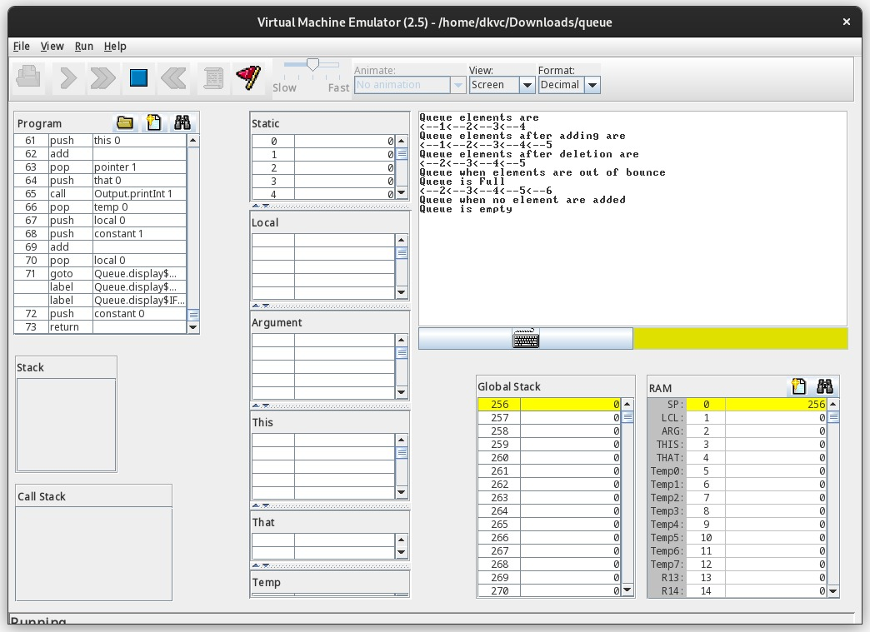
QUEUE
OUTPUT

Slide 29
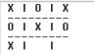
TIC-TAC-TOE
04
The tic tac toe is a really simple game and the rules are widely known.
Our game will use a 2D array to represent the board, and it will be console based, meaning you will interact with the game using the console.

Slide 30
TIC-TAC-TOE
API :
Main
Variables | Parameter | Return Type | Description
Split | str (String), String (delim) | Array | Splits the String before de-lim and stores it in an array
countWords | str (String), String (delim) | int | Returns number of word in a given String

Slide 31
TIC-TAC-TOE
API :
Fields for storing values in Tic-tac-toe
Name | Data Type | Description
Board | Array of Arrays | Stores the values in the board
currentPlayer | Integer | Who is the current Player?
currentPlayerSymbol | String | What is the current Value? (X or O)

Slide 32
TIC-TAC-TOE
API :
Fields (Used for Comparing)
Name | Data Type | Description
blank (“ “) | String | Blank String for comparing
X (“X”) | String | String Letter “X” for comparing
O (“O”) | String | String Letter “O” for comparing

Slide 33
TIC-TAC-TOE
API :
Methods (User interface)
Name | Parameters | Return Type | Description
TicTacToe (Constructor) | - | Object (TicTacToe) | Creates an instance of class
drawBoard | - | Void | Draws the Tic Tac Toe Grid
UI | - | Void | Draws Interface for Input and Grid

Slide 34
TIC-TAC-TOE
API :
Methods (Methods for changing the User interface)
Name | Parameters | Return Type | Description
changeCurrentPlayer | - | Void | Changes the Current Player and value
setX | Position (int) | Void | Changes Value from blank to X at given position
setO | Position (int) | Void | Changes Value from blank to O at given position

Slide 35
TIC-TAC-TOE
API :
Methods (Helper Methods for changing the User interface)
Name | Parameters | Return Type | Description
currentPlayerSymbol | Position (int) | String | Returns the corresponding value at given position
setValue | Position (int), Value (String) | Void | Sets the given value at given position
remainder | Dividend (int), Divisior (int) | Integer | Returns the Remainder of given values

Slide 36
TIC-TAC-TOE
API :
Logical methods for checking the condition
Name | Parameters | Return Type | Description
currentPlayerSymbol | Position (int) | String | Returns the corresponding value at given position
setValue | Position (int), Value (String) | Void | Sets the given value at given position
remainder | Dividend (int), Divisior (int) | Integer | Returns the Remainder of given values

Slide 37
TIC-TAC-TOE
API :
Logical methods for checking the condition
Name | Parameters | Return Type | Description
currentPlayerSymbol | Position (int) | String | Returns the corresponding value at given position
setValue | Position (int), Value (String) | Void | Sets the given value at given position
remainder | Dividend (int), Divisior (int) | Integer | Returns the Remainder of given values

Slide 38
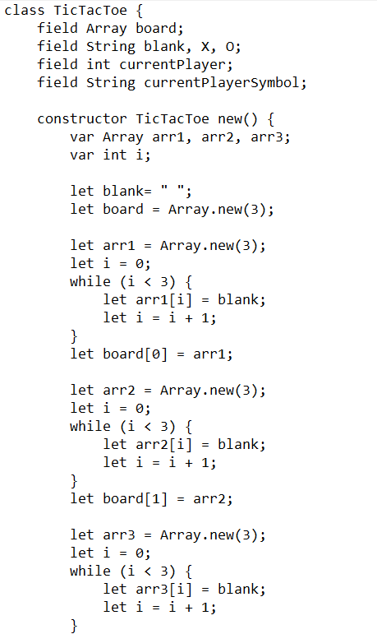
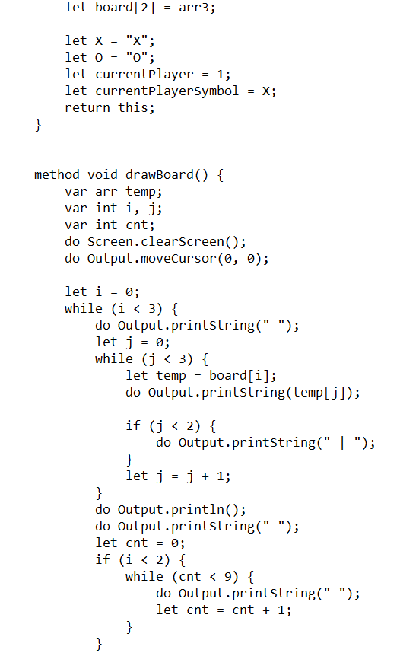
TIC-TAC-TOE
JACK CODE :

Slide 39
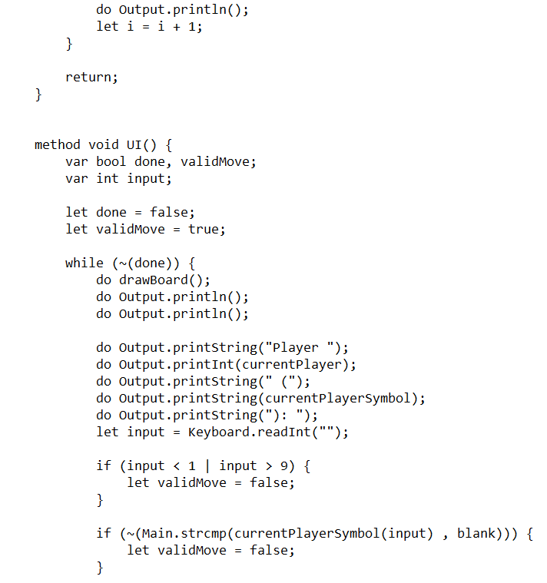
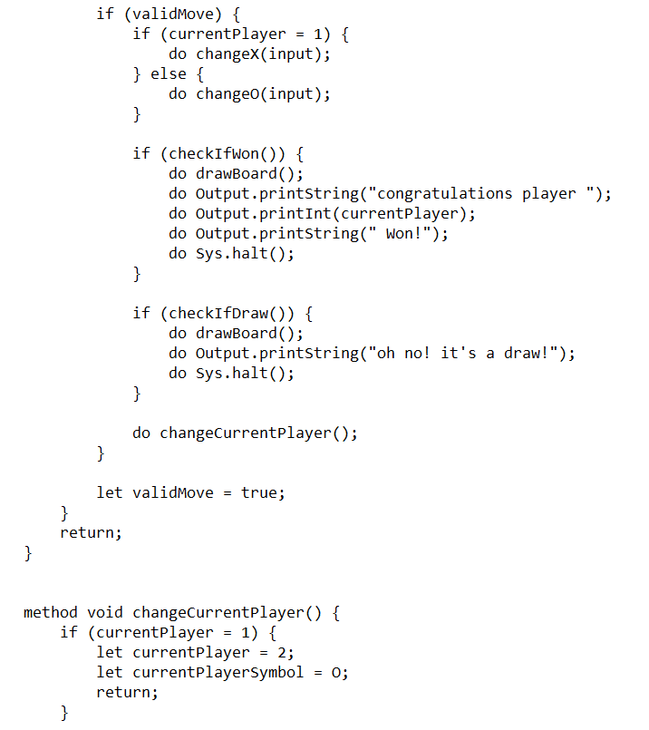

Slide 40
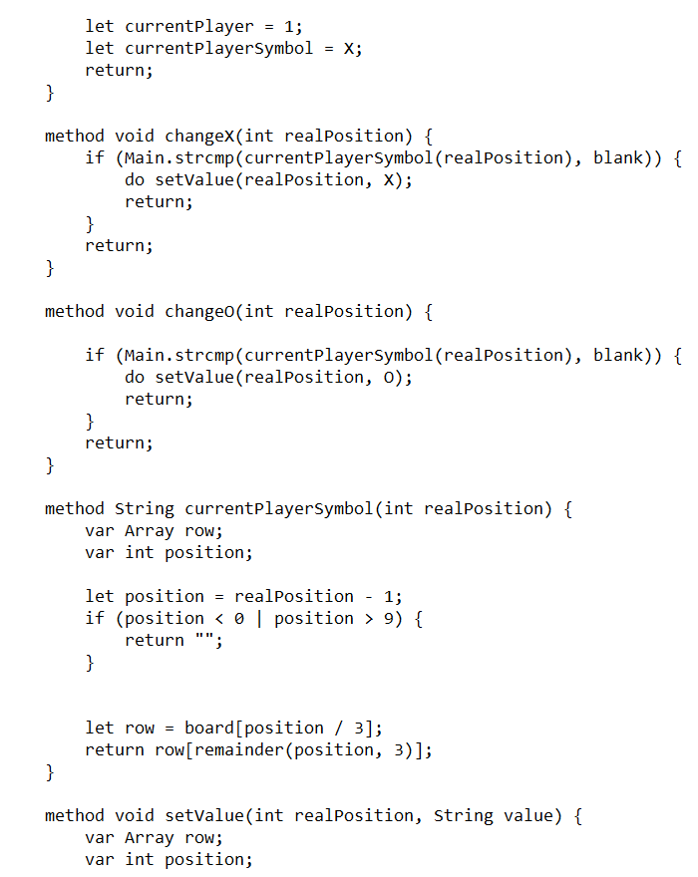
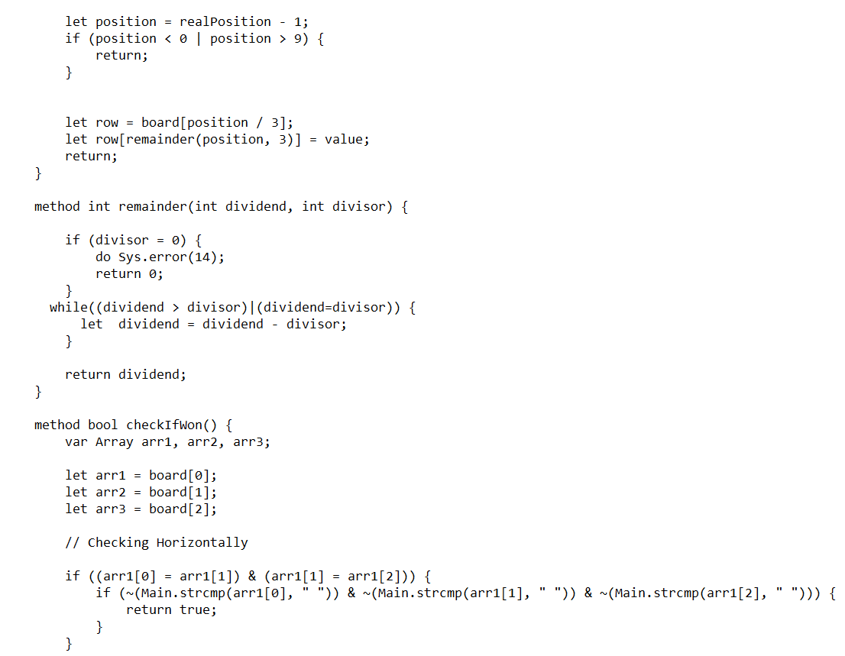

Slide 41
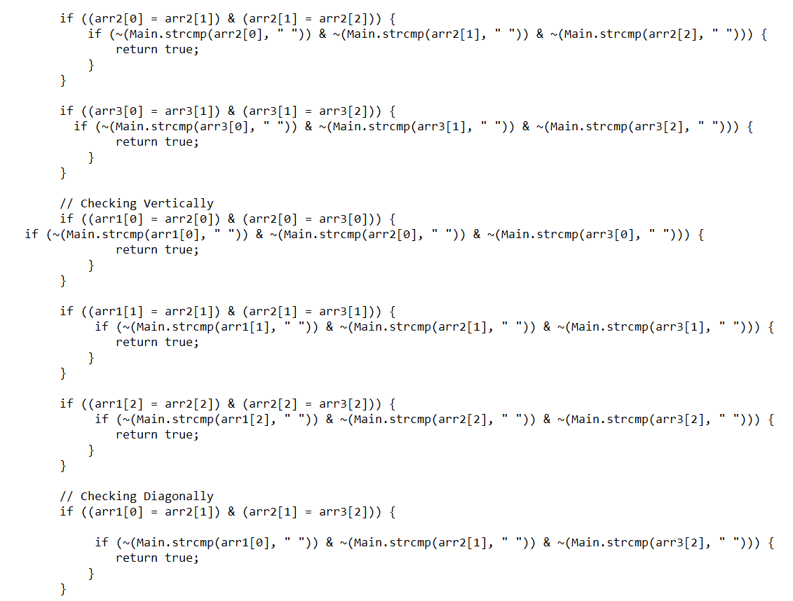

Slide 42
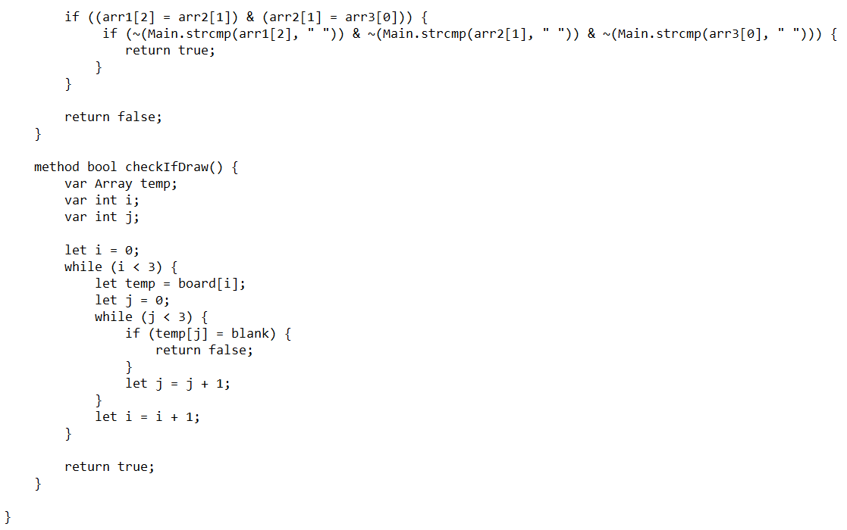

Slide 43
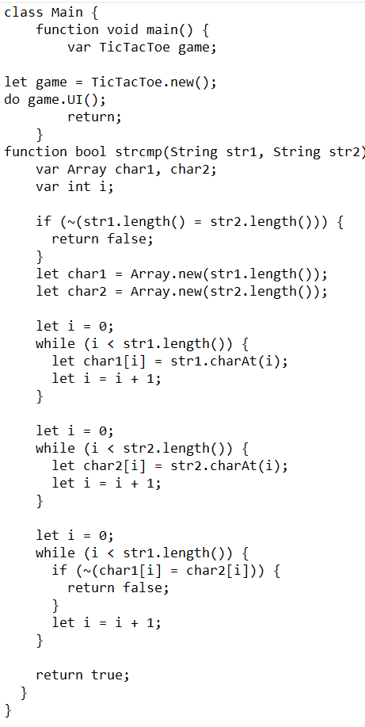
Main.JACK
class Main {
function void main() {
//calling the method UI by creating a object of class tic tac toe
}
function String strcmp(Argument one, Argument two) {
//if strings length are not equal returns false
//stores each character of given string in character Arrays and checks each character at each index
//if strings are not equal returns false
//if strings are equal returns True
}
}

Slide 44
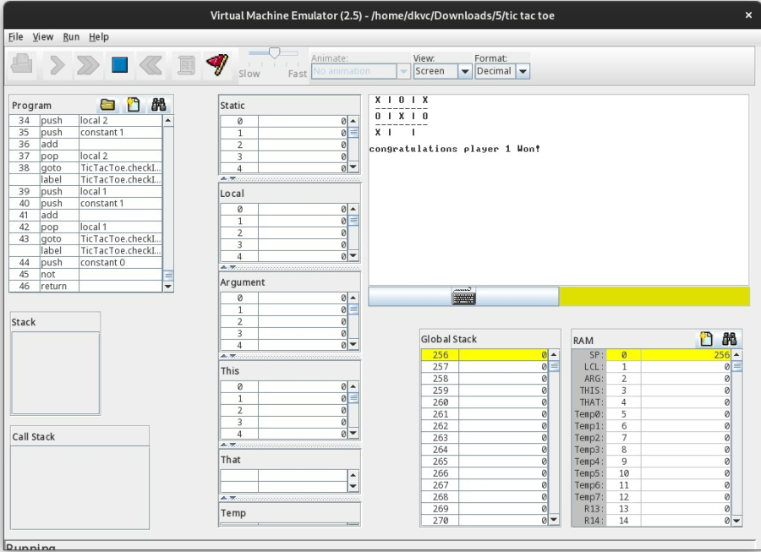
TIC-TAC-TOE
OUTPUT
(player 1 winning)

Slide 45
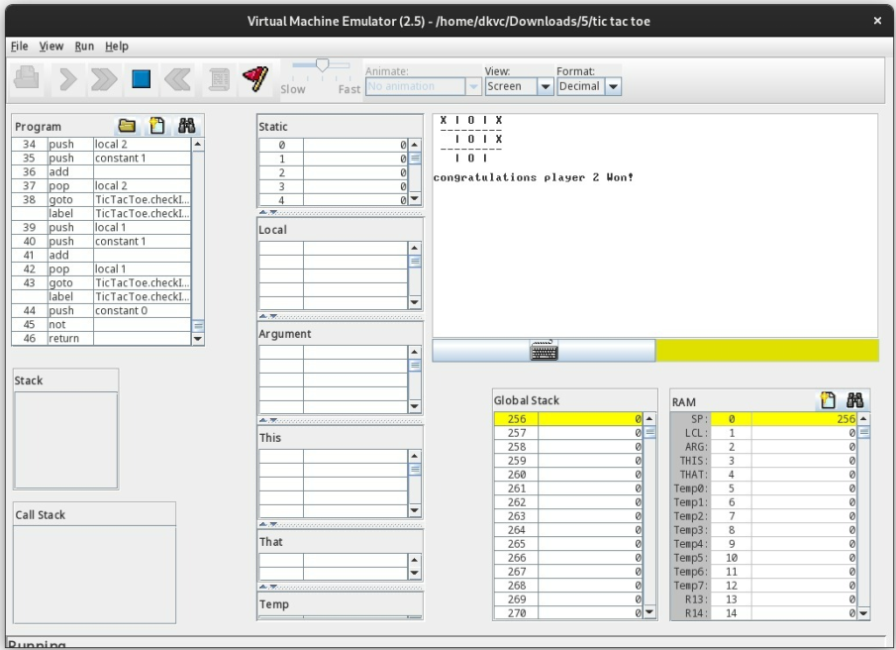
TIC-TAC-TOE
OUTPUT
(player 2 winning)

Slide 46
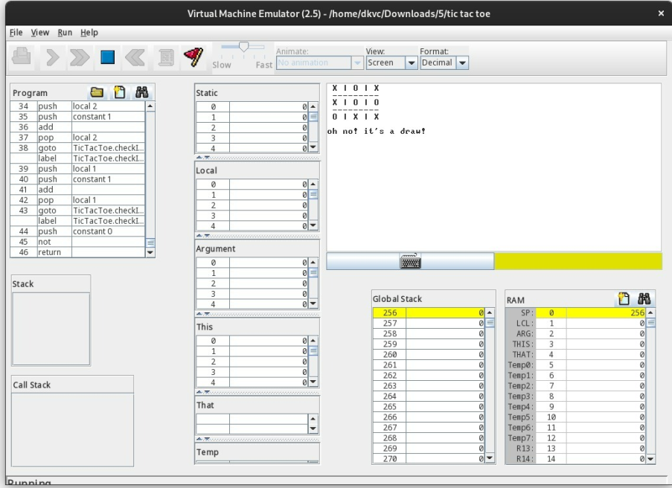
TIC-TAC-TOE
OUTPUT
(both players draw)

Slide 47
Conversion from .jack to .vm files
Jack Compiler, converts .jack files to .vm files. .vm files are executed by VM Emulator
Conversion from .vm to .asm files
VM Translator converts .vm files to .asm files.
Conversion from .asm to .hack files
Assembler converts .asm files to .hack files

Slide 48
Write your own general purpose assembler to convert the assembly program into 16 bit machine codes also use the Nand2tetris assembler for conversion. (Your own assembler should be developed by you and is different from the assembler tool supplied along with the book)
PART-2
All .asm files are converted to .hack files and their comparisons are successful. Some of the outputs while comparing are shown

Slide 49
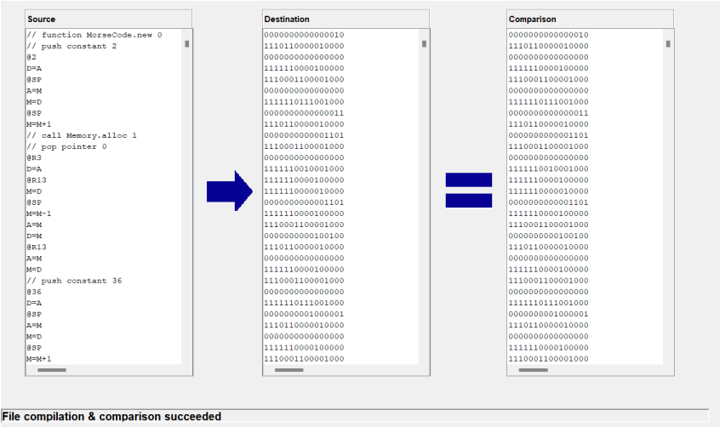
MORSECODE
OUTPUT OF COMPARISON

Slide 50
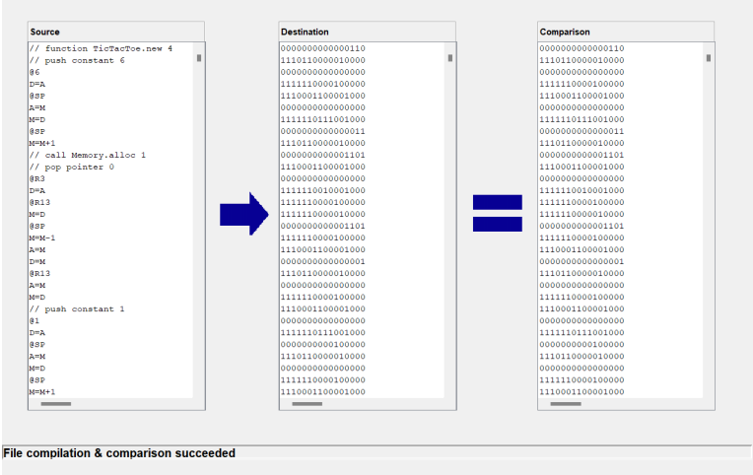
TIC-TAC-TOE
OUTPUT OF COMPARISON

Slide 51
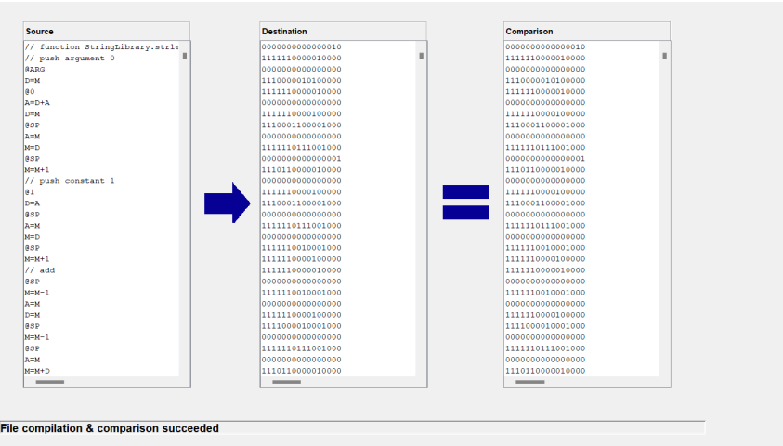
STRING LIBRARY
OUTPUT OF COMPARISON

Slide 52
THANK YOU

